Slide 1
Computer Networks
Lec 1 - Introduction
Asst. Prof. Dr. Faisal Bashir

Slide 2
Some Ground Rules
Let’s make this educational and enjoyable.
It’s a big class, and it’s easy for things to get out of hand, so please…
  Let me do the talking
  Raise hands for questions and no whispering
  Listen to other people’s questions.
  Be here.
  Be here on time.

Slide 3
How to survive this course
Materials sound simple and easy, but they are not.
Do not leave everything to the exam night!.
Not copy the homework!, try them by yourself.
You can read the course by yourself, but the class makes the life for you easier.
Unannounced quiz! So be prepared.

Slide 4

Textbook
  Computer Networking: A Top-Down Approach, 5th ed by Kurose and Ross, 2010
Reference books
  Computer Networks by A. Tanenbaum, Prentice Hall, 4th ed
  Computer Networks, A Systems Approach by L. Peterson and B. Davie

Slide 5
What Will We Cover?
A complete schedule will be posted at: learning management system; http://learn.mcs.edu.pk/
Networking architecture and design principles
Applications
  application paradigms; high performance network app.
  HTTP/Web, Email, DNS, P2P
  Sockets
Transport
  multiplexing/de-multiplexing
  transport services
  reliability
  transport protocols: TCP/UDP

Slide 6
What Will We Cover?
Network
  network services
  distributed, asynchronous, autonomous routing algorithms; scalable router design
  IP4/IPv6
  Operation of routers
Link and physical
  multiple access; queueing analysis; capacity analysis
  Ethernet, 802.11
  Encoding schemes
  Types and characteristics of physical media

Slide 7
Grading Policy
Final 50 Marks
Mid term 30 Marks
Assignments 10 Marks
Quiz 10 Marks
Class Participation = 5 extra marks

Slide 8
Course Objective
To understand the architecture, working and operation of computer networks

Slide 9
Agenda
Communication
History of Internet
Protocol Layers

Slide 10
Communication

Slide 11
Communication as a human being need.
Base of community
  Collection of trees is not a community.
Transferring data, knowledge, experience among people
  Base of civilization.
Psycological need.
  Love, affection.
  Just talking.
  Releasing someone.
  Base of Culture.

Slide 12
Communication elements
Producer, Sender
  Speaker (in conversation)
Consumer, Receiver
  Listener
  They both do have processing-limitation
Message- Talk
Transfer media, like air
  Substance
  Capacity (very limited)
  Delay (considerable)

Slide 13
Advancements in Communication
First step – Writing
Next step – Mailing
Telegraph
Telephone
  In 1876, While working on multiplexing telegraph, invented By A. Graham Bell.
Computer Networks

Slide 14
HISTORY OF INTERNET

Slide 15




What’s the Internet: “nuts and bolts” view
PC
millions of connected computing devices: hosts = end systems
  running network apps
server
wireless
laptop
routers: forward packets (chunks of data)
cellular
handheld
communication links
  fiber, copper, radio, satellite
  transmission rate = bandwidth
router
access
points
wired
links

Slide 16
A Brief History of the Internet
1957
  USSR launched Sputnik; US DoD formed Advanced Research Projects Agency (ARPA) (renamed DARPA) and NASA
1961
  First paper on packet switching theory
1964
  Paul Baran from RAND on design of packet switching networks
1965-1968
  ARPANET plan
  4 sites were connected
  First packet switching node Interface
  Message Processors (IMPs)
Notes:
RAND Corporation (Research ANd Development[2]) is a nonprofit global policy think tank first formed to offer research and analysis to the United States armed forces by Douglas Aircraft Company.
The Interface Message Processor (IMP) was the packet-switching node used to interconnect participant networks to the ARPANET from the late 1960s to 1989. It was the first generation of gateways, which are known today as routers

Slide 17
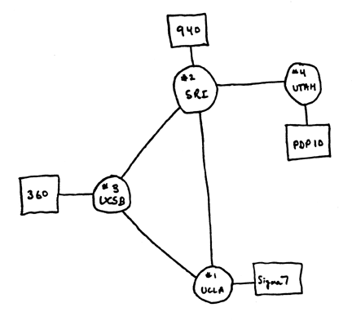
Initial ARPANET
1969
  ARPANET commissioned: 4 nodes, 50kbps
University of California, Los Angeles (UCLA), Sigma 7 first computer
The Stanford Research with the SDS 940 that ran NLS, named "Genie"
University of California, Santa Barbara (UCSB), with IBM 360/75, running OS/MVT
The University of Utah's Computer Science Department, running a DEC PDP-10 running TENEX.

Slide 18
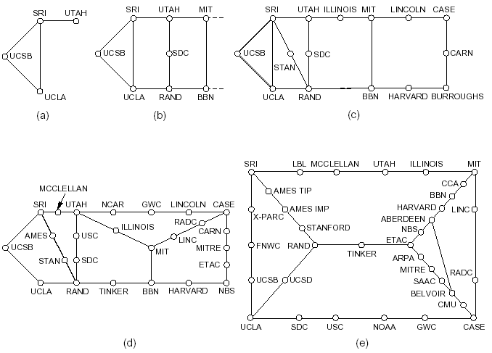
Initial Expansion of the ARPANET
Dec. 1969
July 1970
Mar. 1971
Apr. 1972
Sept. 1972
RFC 527: ARPAWOCKY; RFC 602: The Stockings Were Hung by the Chimney with Care

Slide 19
The Internet Becomes a Network of Networks
1970: ALOHAnet, the first packet radio network, developed by Norman Abramson, Univ of Hawaii, becomes operational
1973: Bob Kahn poses the Internet problem---how to connect ARPANET, packet radio network, and satellite network
1974: Vint Cerf, Bob Kahn publish initial design of TCP (NCP) to connect multiple networks
  - 1978: TCP (NCP) split to TCP/IP
  - 1983: TCP (NCP) converted to TCP/IP (Jan. 1)
Notes:
ALOHAnet, also known as the ALOHA System[1][2], or simply ALOHA, was a pioneering computer networking system developed at the University of Hawaii[3]. ALOHAnet became operational in June, 1971, providing the first demonstration of a wireless data network[4].
Network control protocol NCP

Slide 20
Growth of the Internet
1986: NSF builds NSFNET as backbone, links 6 supercomputer centers, 56 kbps; this allows an explosion of connections, especially from universities
1987: 10,000 hosts
1988: NSFNET backbone upgrades to 1.5Mbps
1989: 100,000 hosts

Slide 21
Web and Commercialization of the Internet
1990: ARPANET ceases to exist
1991: NSF lifts restrictions on the commercial use of the Net; European Organization for Nuclear Research (CERN) released World Wide Web
1992: 1 million hosts
1994: NSF reverts back to research network; the backbone of the Internet consists of multiple private backbones
2009: backbones run at 10 Gbps, some updated to 40 Gbps, ~700 mil. computers in 150 countries
For more on Internet history, please see http://www.zakon.org/robert/internet/timeline/

Slide 22
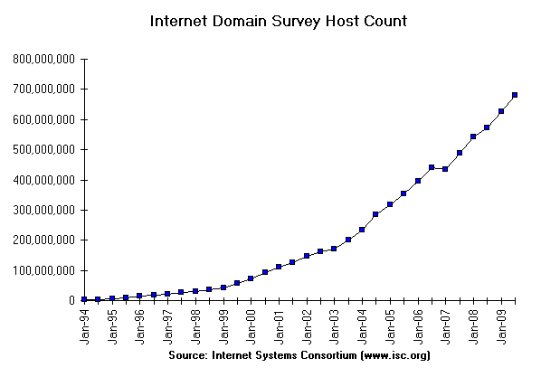
Growth of the Internet in Terms of Number of Hosts

Slide 23
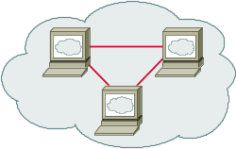

Internet Physical Infrastructure
Backbone
ISP
ISP

Slide 24
Internet structure: network of networks
roughly hierarchical
at center: “tier-1” ISPs (e.g., Verizon, Sprint, AT&T, Cable and Wireless), national/international coverage
  treat each other as equals
Tier-1 providers interconnect (peer) privately
Tier 1 ISP
Tier 1 ISP
Tier 1 ISP

Slide 25
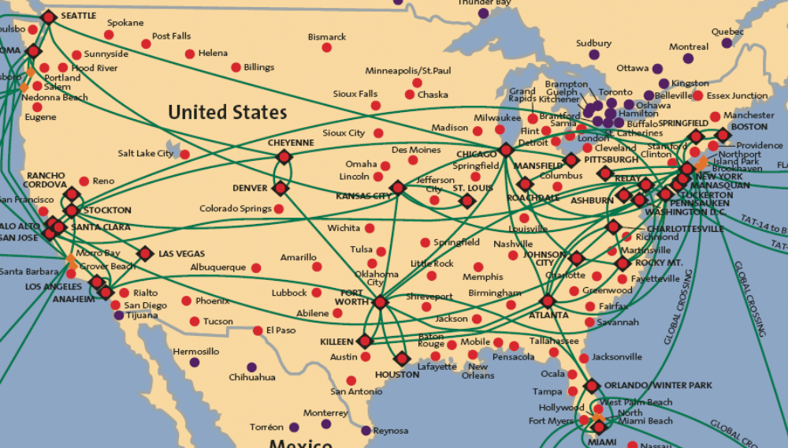
Tier-1 ISP: e.g., Sprint, AT&T, GBLX, Qwest, L3
POP: point-of-presence
to/from backbone
…
peering
….
…
…
…
to/from customers

Slide 26
Internet structure: network of networks
“Tier-2” ISPs: smaller (often regional) ISPs
  Connect to one or more tier-1 ISPs, possibly other tier-2 ISPs
Tier-2 ISPs also peer privately with each other.
Tier-2 ISP pays tier-1 ISP for connectivity to rest of Internet
tier-2 ISP is customer of
tier-1 provider
Tier-2 ISP
Tier-2 ISP
Tier 1 ISP
Tier 1 ISP
Tier 1 ISP
Tier-2 ISP
Tier-2 ISP
Tier-2 ISP

Slide 27
Internet structure: network of networks
“Tier-3” ISPs and local ISPs
  last hop (“access”) network (closest to end systems)
local
ISP
Tier 3
ISP
local
ISP
local
ISP
local
ISP
Local and tier- 3 ISPs are customers of
higher tier ISPs
connecting them to rest of Internet
Tier-2 ISP
Tier-2 ISP
Tier 1 ISP
Tier 1 ISP
Tier 1 ISP
Tier-2 ISP
Tier-2 ISP
Tier-2 ISP
local
ISP
local
ISP
local
ISP
local
ISP

Slide 28
Internet structure: network of networks
a packet passes through many networks!
local
ISP
Tier 3
ISP
local
ISP
local
ISP
local
ISP
Tier-2 ISP
Tier-2 ISP
Tier 1 ISP
Tier 1 ISP
Tier 1 ISP
Tier-2 ISP
Tier-2 ISP
Tier-2 ISP
local
ISP
local
ISP
local
ISP
local
ISP

Slide 29
Protocol “Layers”
Networks are complex!
many “pieces”:
  hosts
  routers
  links of various media
  applications
  protocols
  hardware, software
Question:
Is there any hope of organizing structure of network?

Slide 30
What’s a protocol?
human protocols:
“what’s the time?”
“I have a question”
introductions
… specific msgs sent
… specific actions taken when msgs received, or other events
network protocols:
machines rather than humans
all communication activity in Internet governed by protocols
protocols define format, order of msgs sent and received among network entities, and actions taken on msg transmission, receipt

Slide 31


What’s a protocol?
a human protocol and a computer network protocol:
Hi
TCP connection
request
Hi
TCP connection
response
Got the
time?
Get http://www.awl.com/kurose-ross
2:00
<file>
time

Slide 32
Internet protocol stack
application: supporting network applications (FTP, SMTP, HTTP)
transport: process-process data transfer (TCP, UDP)
network: routing of datagrams from source to destination
  IP, routing protocols
link: data transfer between neighboring network elements
  PPP, Ethernet
physical: bits “on the wire”
application
transport
network
link
physical

Slide 33
Encapsulation
source
message
M
application
transport
network
link
physical
segment
H_{t}
M
H_{t}
datagram
H_{n}
H_{n}
H_{t}
M
frame
H_{l}
H_{n}
H_{t}
M
link
physical
switch
destination
H_{n}
H_{t}
M
network
link
physical
M
application
transport
network
link
physical
H_{l}
H_{n}
H_{t}
M
H_{n}
H_{t}
M
H_{t}
M
H_{n}
H_{t}
M
H_{l}
H_{n}
H_{t}
M
router

